Slide 1


Advisor : Hoon Sung Chwa
Weekly Meeting
2023.04.20
Dept of Information & Communication Engineering, DGIST
Real-Time Computing Lab
Kang Young Eun ( kye0520 @dgist.ac.kr)

Slide 2
Content
Introduction
Motivation
Model Design
Evaluation
2

Slide 3
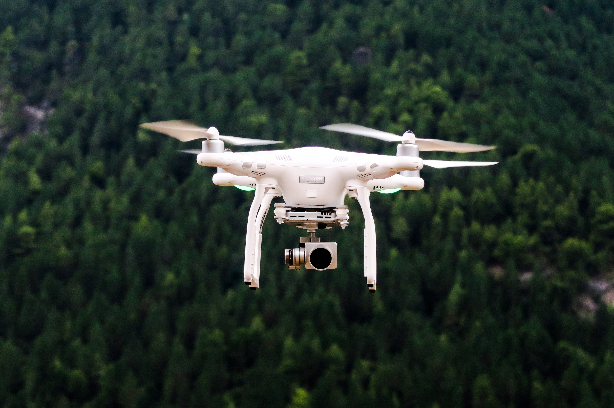
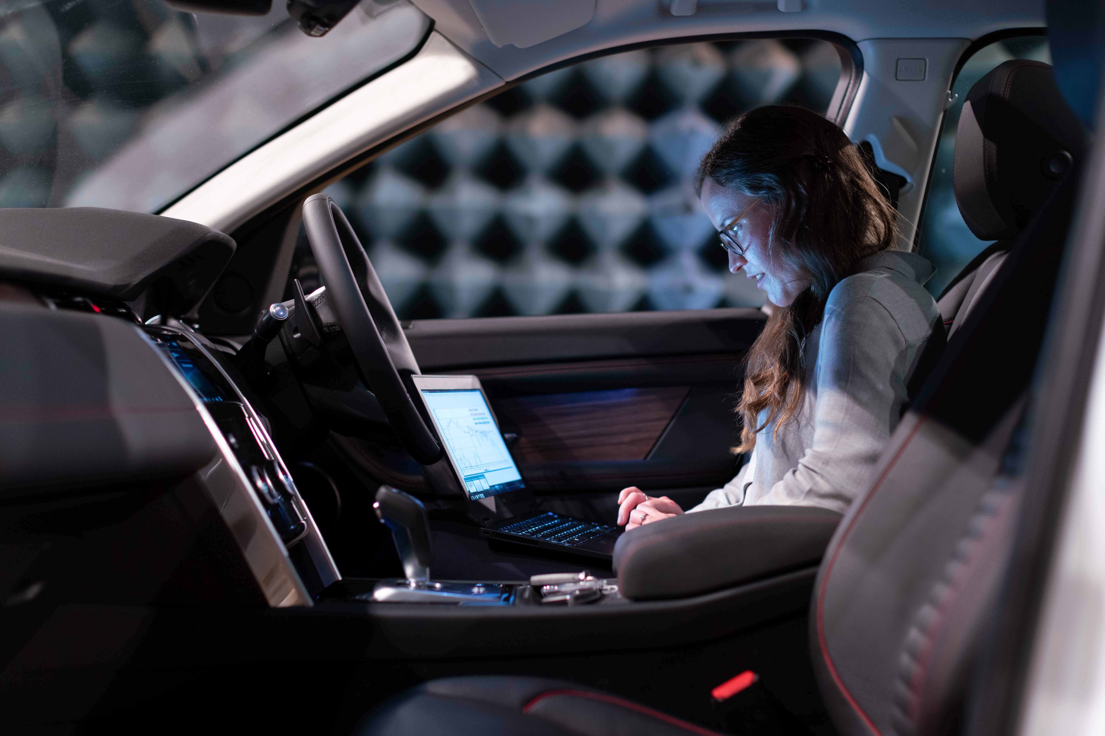
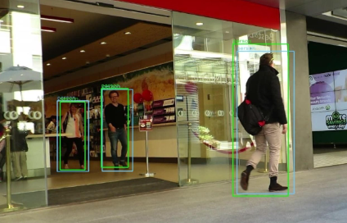
Introduction
Deep Neural Networks
Deep Neural Networks (DNNs) are increasingly used in various real-time applications.
Object Detection Tasks in Real-time applications
Surrounding environment of Avs and drones
Drones
Autonomous Vehicles
Object Detection
3
Notes:
Dnn은 d, a와 같은 다양한 real-time application 많이 활용되고 있따.
특히 object detection task가 중요하고 많이 활용되고 있다.

Slide 4
Introduction
Challenge of Real-time Object detection tasks
High computational demand of Deep Neural Networks
Deadline constraints in real-time applications
High Computations of DNNs
Deadline Constraints
Goal
Computation saving framework for real-time object detection tasks that meets deadline without detection accuracy loss.
4
Notes:
그렇지만 아직 object detection task를 실제로 활용하기 위해서는 challenge가 있다. 연산량이 많아 실시간성을 보장하기 어렵다는 것이다.
이러한 문제점을 해결하기 위해서 본 연구의 목표를
연산량을 줄여 deadline을 만족하면서도 accuracy loss를 줄일 수 있는 시스템으로 설정하였다.

Slide 5
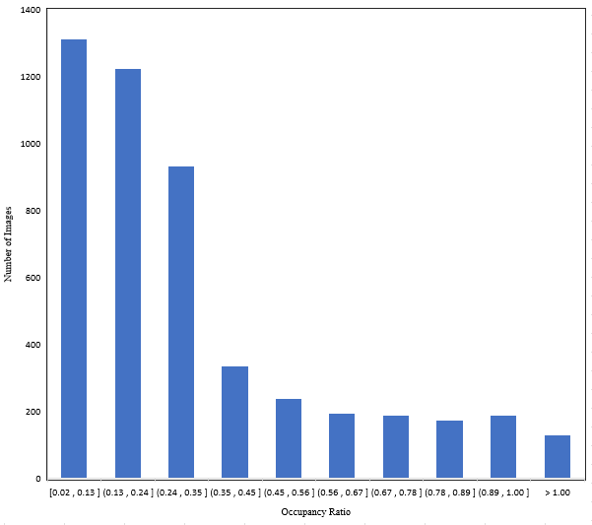
Motivation
Observation 1
Proportion of Region of Interest (RoI) in an image covers a small amount
Region-of-Interest
Occupancy Ratio of RoI in an image
77.8%
5
Notes:
이 문제점을 해결하기 위해서 frame에서 roi의 특성을 활용하고자 한다.
RoI 의 occupancy ratio를 측정한 결과, 이미지에서 차지하는 roi의 비중이 50%도 차지하지 않는 경우가 dataset의 77%나 되었다.

Slide 6
Motivation
Observation 1
Proportion of Region of Interest (RoI) in an image covers a small amount
Region-of-Interest
Occupancy Ratio of RoI in an image
77.8%
Original Image Size
RoI Patching
6
Notes:
따라서 복잡한 연산량을 patching하여 RoI 부분만을 detection 수행함으로써
연산량을 줄이고자 하였다.

Slide 7
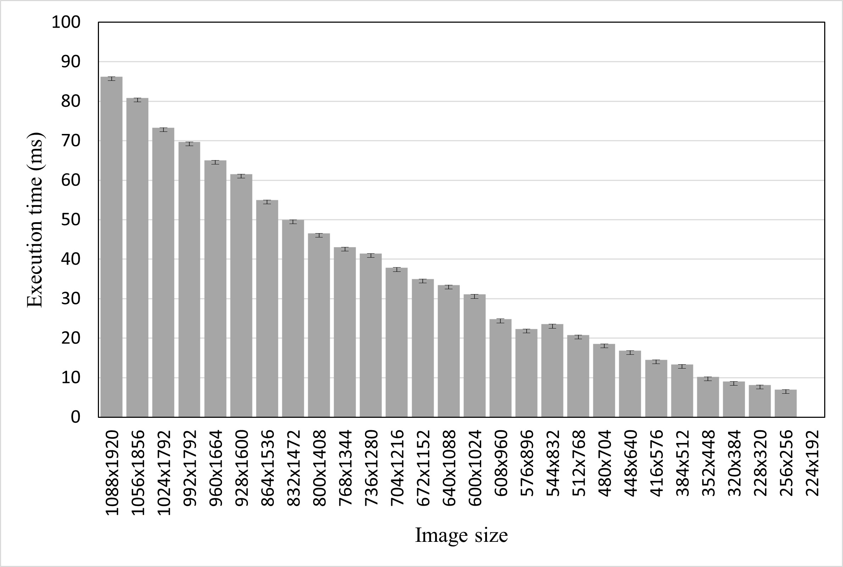
Motivation
Observation 2
Execution time of DNN inference task is predictable by image resolution.
Inference execution time with different image resolution
0.0037
0.0002
→ DNNs perform operations, such as convolution, pooling, and fully connected layers depending on the number of pixels in the image.
→ Exploit execution time of image resolution profiled in advance.
7
Notes:
두번째 observation은 inference execution time은 이미지의 size에 따라 예측할 수 있다는 점이다.
적은 편차를 가지기 때문에 이를 바탕으로 미리 profilin한 execution time의 값을 바탕으로 image resolution을 결정하며
실행시간을 조절.
이미지의 resolution에 따라서 결정을 함으로써 deadline을 맞추어주려고한다.

Slide 8
Motivation
Approach
Image Patching Mechanism to resolve high computation problem of DNN tasks.
Select resolution of image according to deadline to satisfy detection deadline.
Goal
Computation saving framework for real-time object detection tasks exploiting image patching that meets deadline.
8
Notes:
이러한 approac를 기반으로 image patching scheme과 deadline을 고려한 object scalin을 바탕으로 dnn의 computatio문제를 해결하고자 한다.
patching 기법과
image size 를 deadlin에 따라 결정하는 방법으로 goal을 달성하고자 한다.

Slide 9
Model Design
Camera Image
RoI Detection
Decision Module
Image Merge
Object Detector
RoI result
Merge Size
1
2
Canvas Size
3
4
Bounding Box Mapping
Yolov5
Detection Result
Post Processing
Image Packing
Recursive Packing
RoI Size Decision
RoI Crop
Patch Module
9
Notes:
전체 overview는 다음과 같다.
RoI를 detection하는 부분과 patch 모듈이 잇고 같은 object detector을 활용한다.
그 결과를 post processing하는

Slide 10
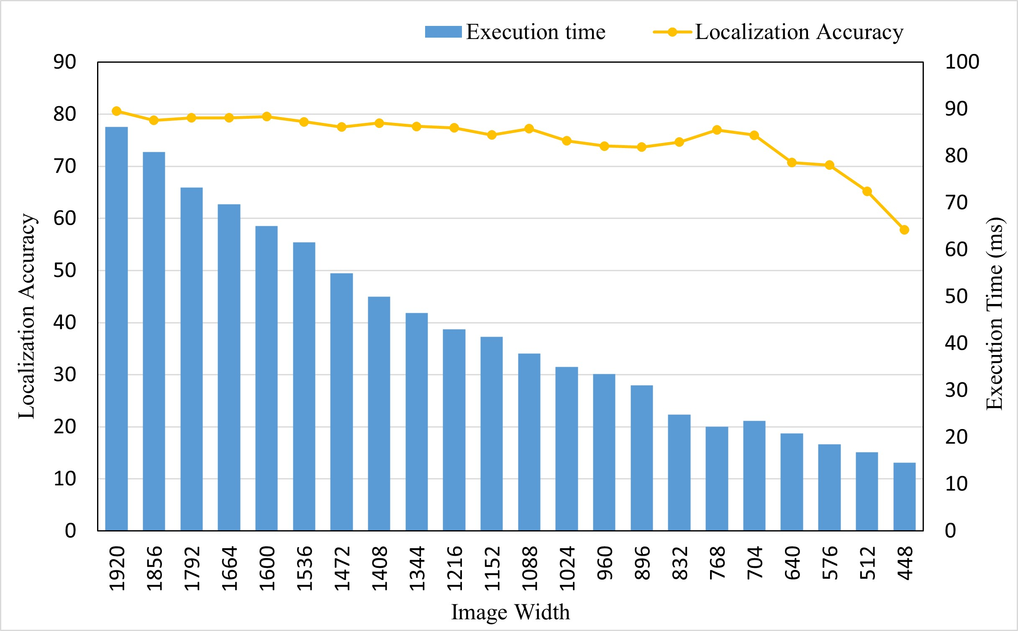
RoI Extraction Process
Image Merge
Image Merge
Object Detector
RoI Results
1
2
3
4
Region-of-Interest
Impact of Localization Accuracy on image resizing with Execution time
Save 66ms of execution time with 2 accuracy loss.
66ms is able to detect image sized 1664.
Localization Accuracy is insensitive to downsizing!
10
Notes:
먼저 RoI detection 은 image merge를 통하여 여러 이미지를 동시에 진행한다.
이렇게 하는 것이 가능한 이유는 Localization은 downsizing에 민감하지 않기 때문이다.
하나의 이미지가 320 일 때

Slide 11
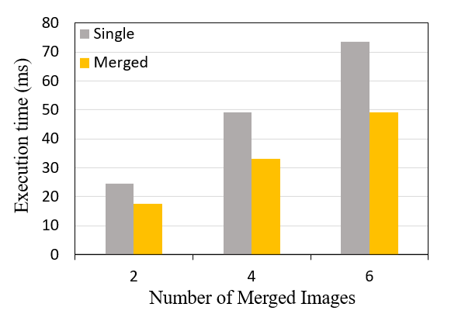
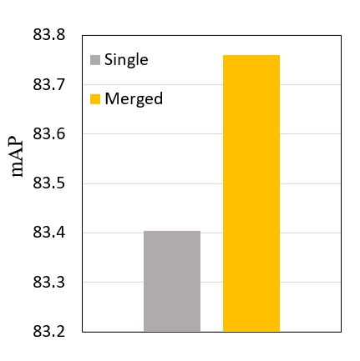
Image Merge
Validity of Image Merge for RoI Detection
Execution time comparison of single image and merged image
Localization accuracy comparison of single image and merged image
0.3 ↑
Merge lowers 1.4x of execution time compared to single image detection.
Merge shows even slightly higher localization accuracy than vanilla.
Therefore, image merge for RoI detection is valid in terms of execution time and accuracy.
11
Notes:
Single detection과 비교해도 execution time과 accuracy 측면에서 낫다는 점을 보인다.
Execution time

Slide 12
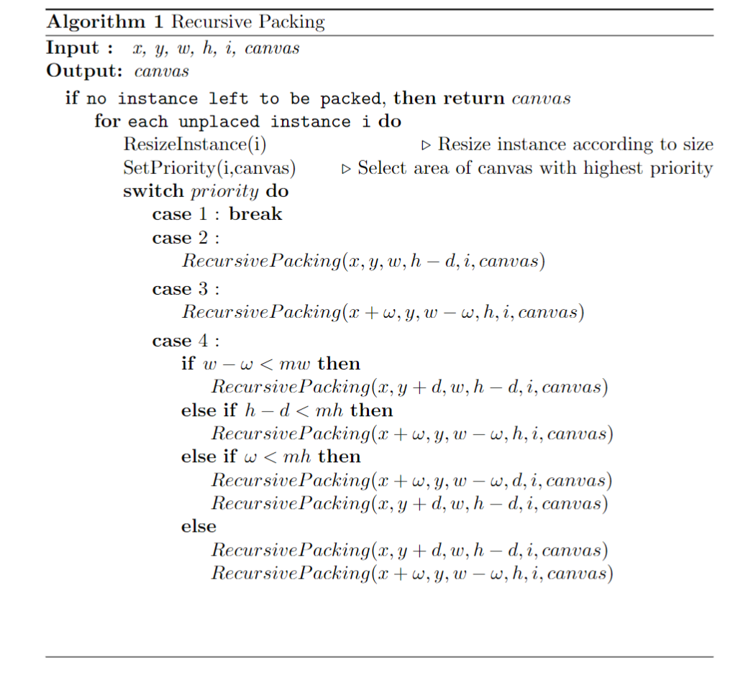
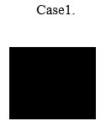
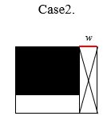
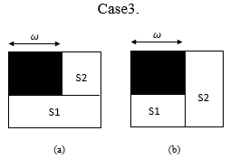


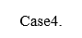
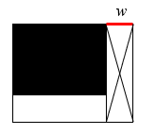
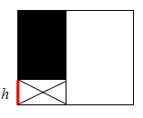
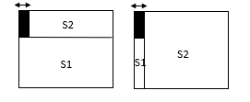

Image Patch
Image Patching Algorithm
Packing objects in a canvas frame is NP-hard rectangular packing problem.
Therefore, we adopt a Priority Heuristic Recursive Packing Algorithm
[1] Zhang, Defu, et al. "A priority heuristic for the guillotine rectangular packing problem." Information Processing Letters 116.1 (2016): 15-21.
12
Notes:
오메가: cropped width
d : cropped h
그렇게 merge를 통해서 RoI를 추출했다면 patching을 진행해야하는데,
하나의 이미지에 object를 packing하는 것은 np-hard problem으로 priority heuristic recursvie packing 방식으로 문제를 해결했다.
먼저 모든 instance에 대해서

Slide 13
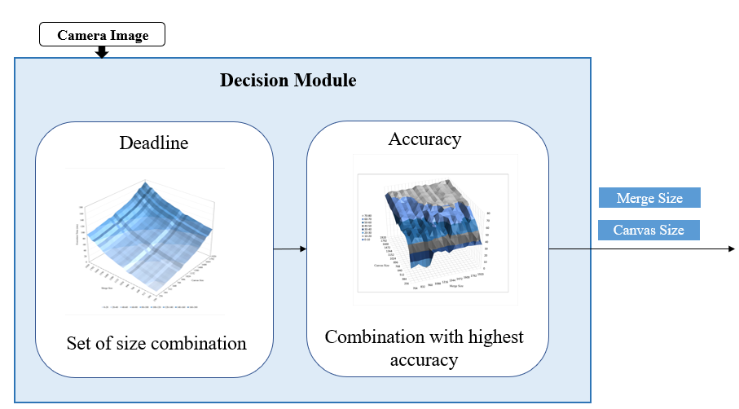
Decision Module
Merge and Canvas Size Decision
Get set of Merge and Canvas Size according to deadline.
Set Merge and Canvas size that can maximize accuracy.
13
Notes:
Merge size와 Canvas size를 결국 결정해야 한다.
이 두 조합의 최적의 값을 찾기 위해서 실험을 진행해보았다.
실행시간은 Linear하게 늘어나고 정확도는 다음과 같은 양상을 보였다.
그 결과

Slide 14
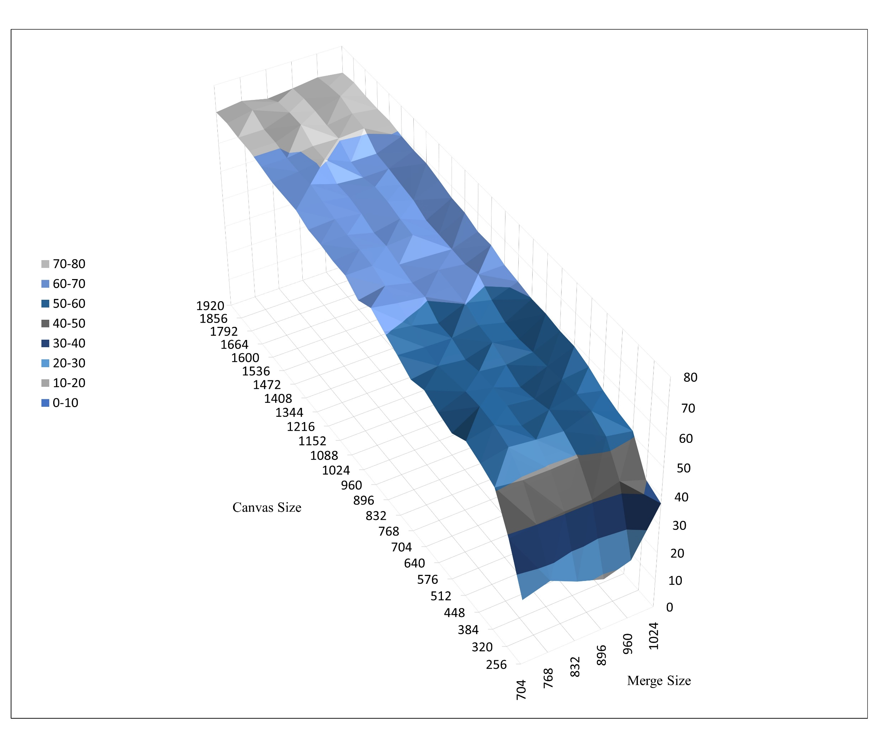
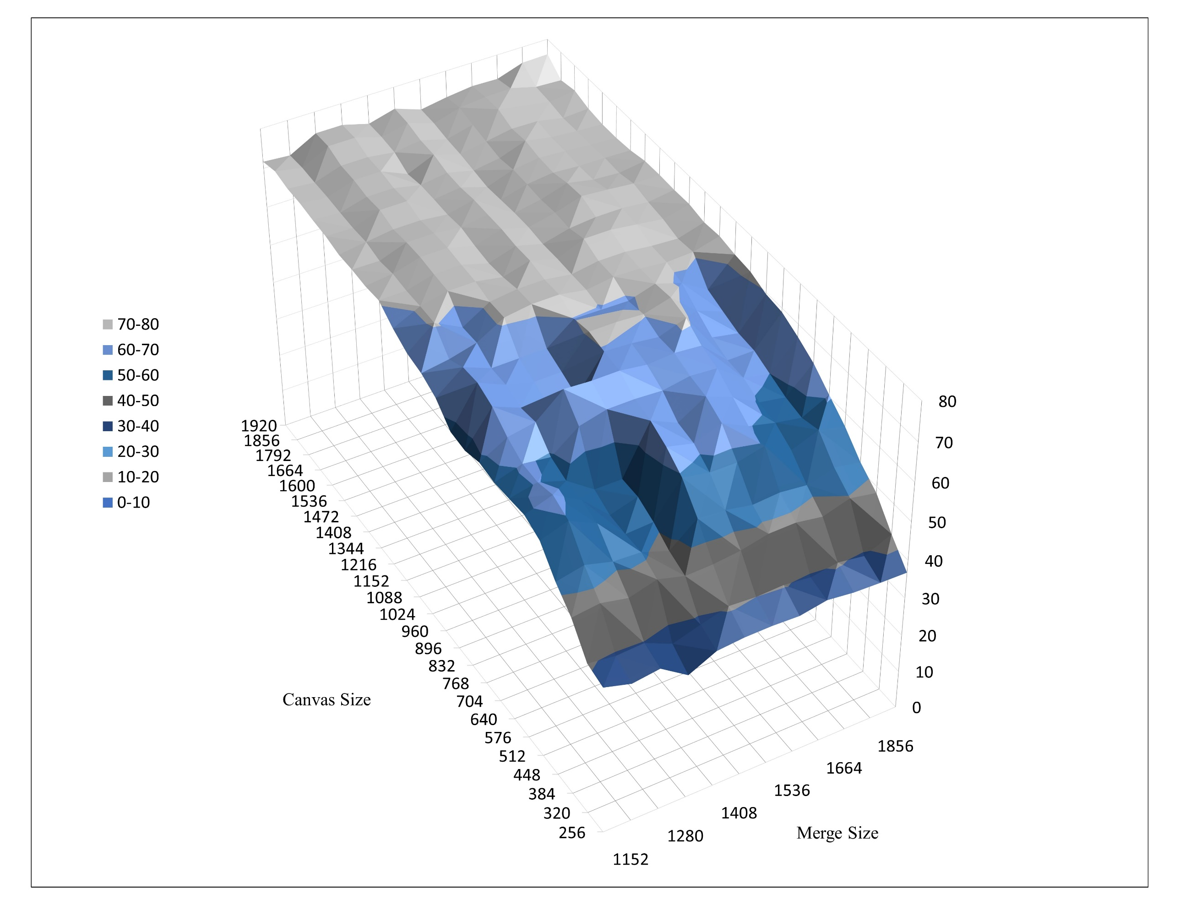
Decision Module
Merge and Canvas Size Decision
Minimum merge size : 640 (One image size 320 )
Execution time of Merge and Canvas Size combination
(a) Merge Size 640~1024
(b) Merge Size 1024~1920
Merge Size select (b) over (a) if possible and minimize.
Maximize canvas size in remaining time.
14

Slide 15
Evaluation
Evaluation
Deadline Miss Comparison
Classification Accuracy
Breakdown latency of Patching framework
Comparison Models
Vanilla : YOLOv5
15
Notes:
deadline miss ratio
Classification accuracy
Breakdown latency of patching framework

Slide 16
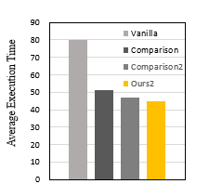
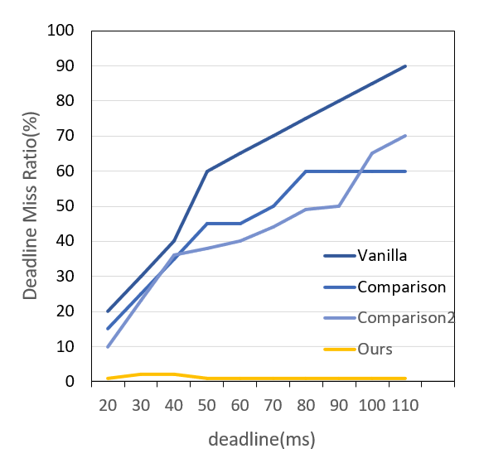
Evaluation
Deadline miss and Accuracy
Expected Graph :
Deadline miss comparison
Expected Graph :
Deadline Miss ratio
Requirement
Purpose : Show proposed model has no deadline miss since merge canvas size is selected according to deadline while vanilla miss deadline.
Purpose : Show proposed model has no or little accuracy loss while meeting deadline.
16
Notes:
Fps requirement/ deadline을 결정할

Slide 17
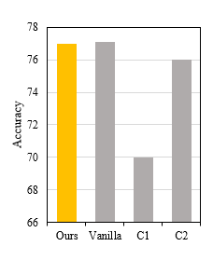
Evaluation
Classification Accuracy
Expected Graph :
Classification Accuracy
Purpose : Show proposed model has no or little accuracy loss while meeting deadline.
17
Notes:
Fps requirement/ deadline을 결정할

Slide 18
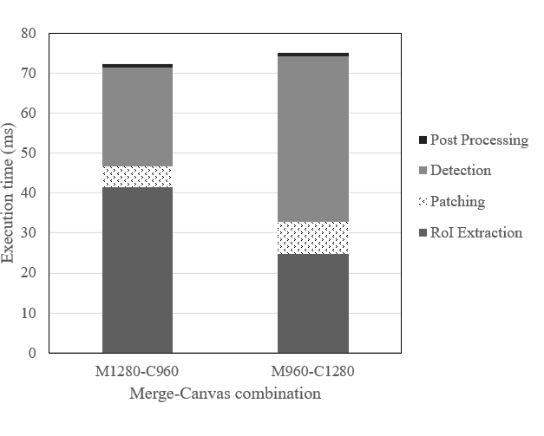
Evaluation
Breakdown latency of Patching framework
5.21%
8%
Even with enlarged canvas size, execution time of patching does not get any higher than 10% of total execution time.
18

Slide 19
To Do
Comparison Models
Evaluation Experiments
Related Work
19

Slide 20

Advisor : Hoon Sung Chwa
Thank you
Dept of Information & Communication Engineering, DGIST
Real-Time Computing Lab
Kang Young Eun (kye0520@dgist.ac.kr)

